Slide 1
October 20
Homework check!!

Slide 2
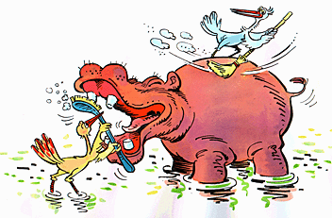
Ecology
Symbiosis

Slide 3
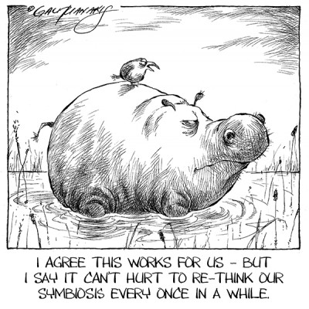
Three Types of Symbiosis
What is Symbiosis?
When two species live in close association with each other
These relationships can be positive, negative, or neutral
There are 3 Types of Symbiosis:
Commensalism
Mutualism
Parasitism

Slide 4
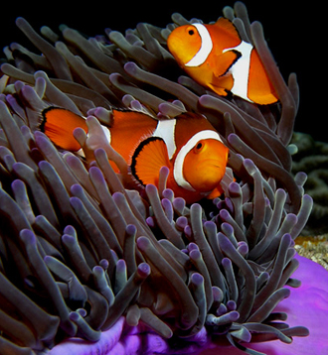
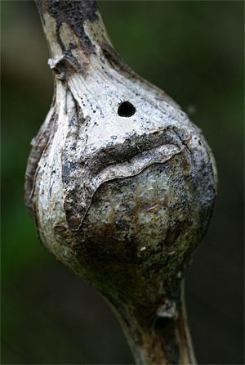
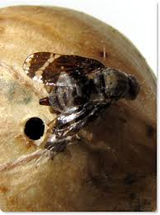
Three Types of Symbiosis
COMMENSALISM
A relationship in which one species derives food or shelter from another species without seriously harming that organism or providing any benefits to that organism in return
+/0 (positive for one species/neutral for the other species)

Slide 5
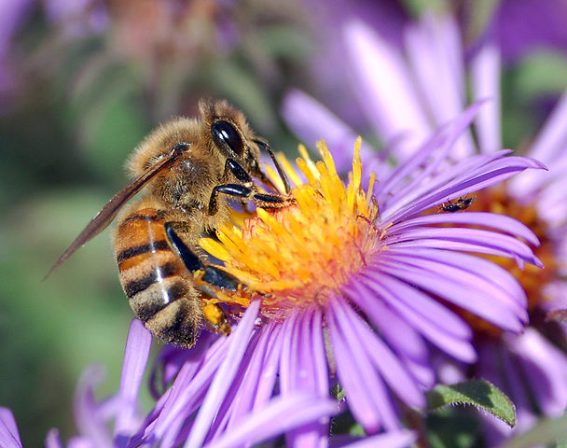
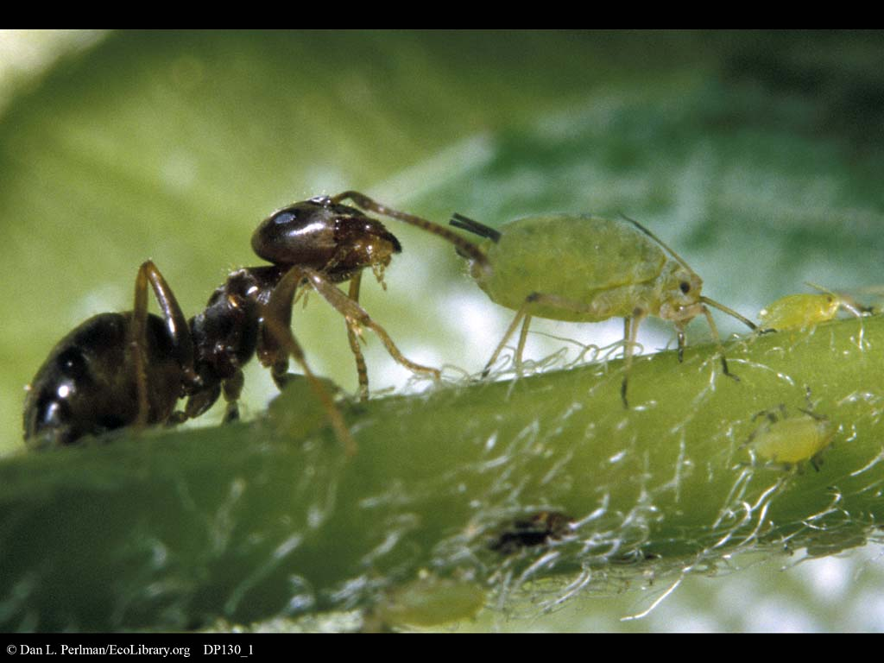
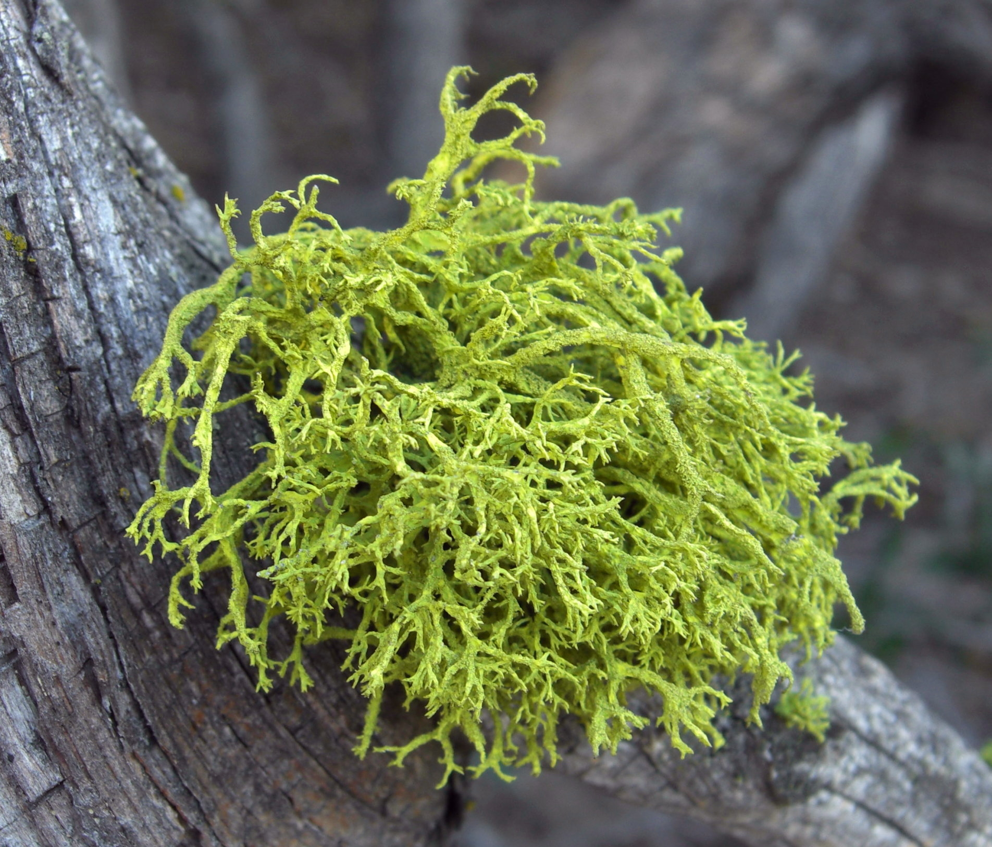
Three Types of Symbiosis
MUTUALISM
A reciprocal relationship in which two different species benefit and are dependent on the relationship
+/+ (positive relationship for both species)

Slide 6
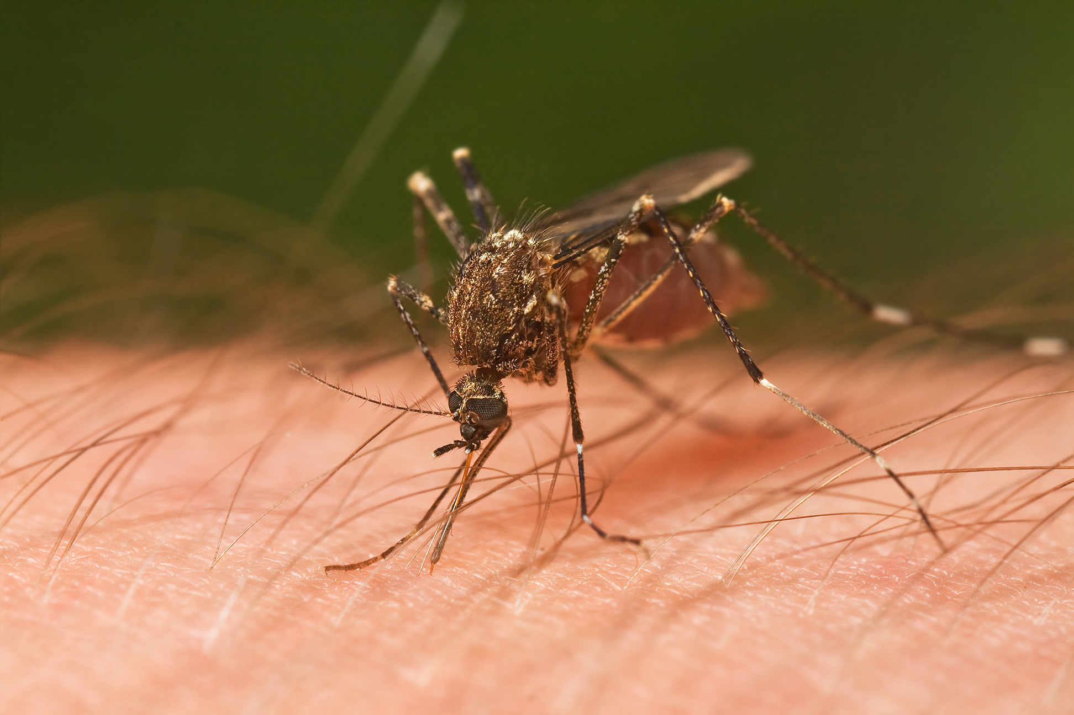
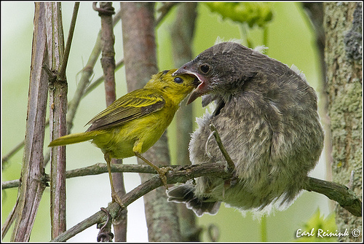
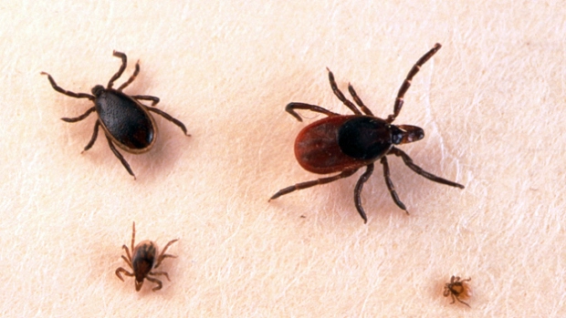
Three Types of Symbiosis
PARASITISM
A relationship between two species in which one species (the parasite) nourishes itself to the detriment of the other species (the host)
+/- (positive relationship for one and negative for the other)

Slide 7
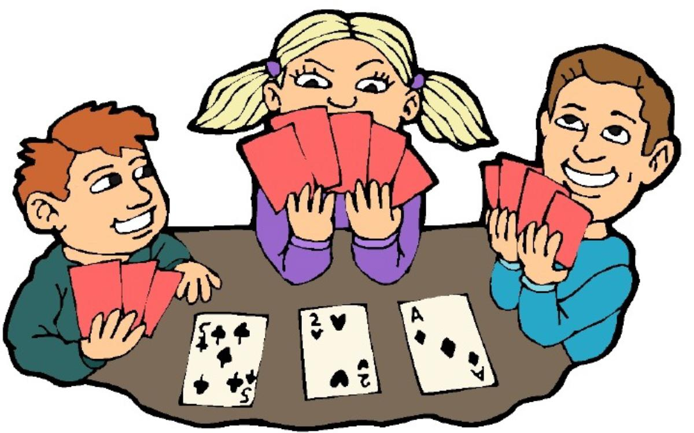
Good Buddies!
A little matching activity!
Draw a card from the deck and find your symbiosis buddy!
What symbiotic relationship do you have with your buddy?
Let’s play a game!!

Slide 8
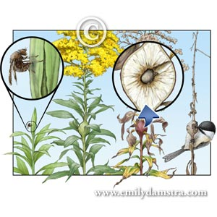
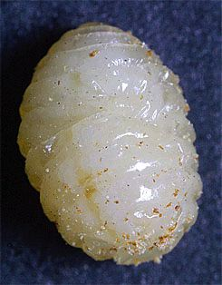
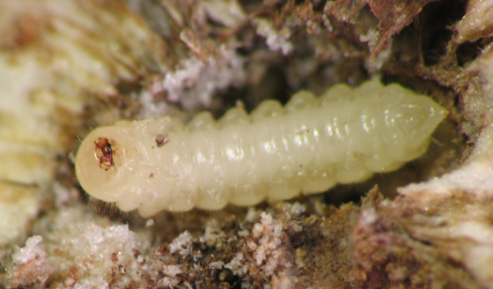
Goldenrod Gall Dissection
Now more fun!
Investigating Goldenrod Galls!
Goldenrod Fly Larvae
Wasp Larvae
Life Cycle

Slide 9
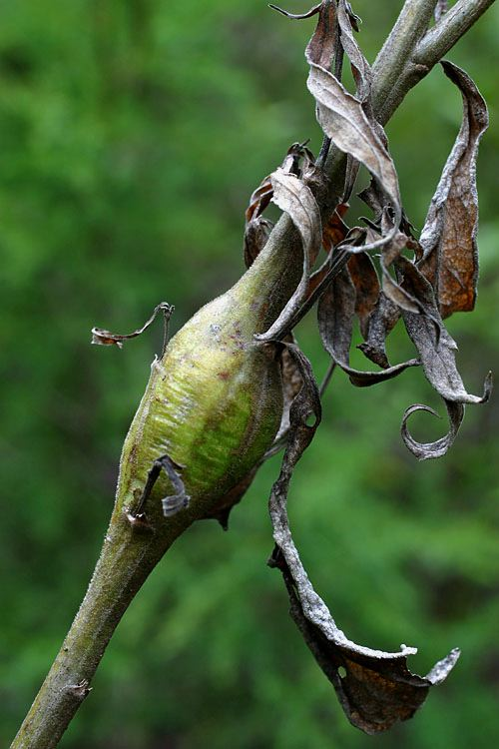
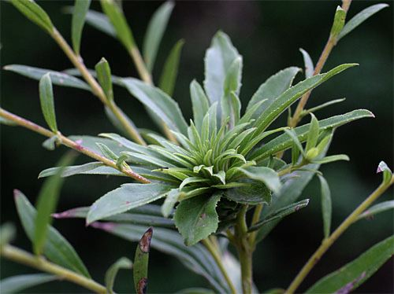
Three Kinds of Galls
Apple Gall or Ball Gall
Eggs layed in Spring
Goldenrod Fly
Rosette gall or Flower Gall
Elliptical Gall
Eggs layed in Summer
Goldenrod Midge
Eggs layed in Fall
Goldenrod Gall Moth

Slide 10
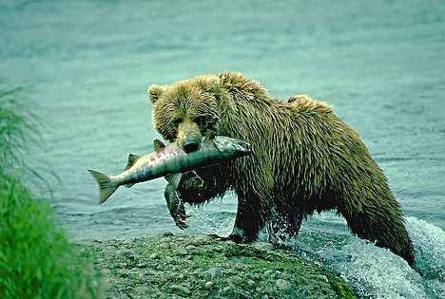
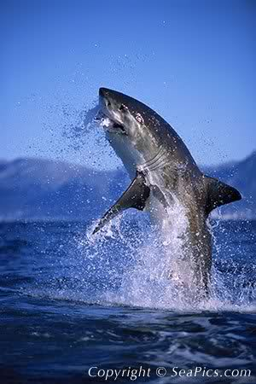
Predator/Prey Relationships

Slide 11
Predator or Prey?
Predation – act of one organism eating another organism
Predator – organism that does the eating
Prey – organism that gets eaten

Slide 12
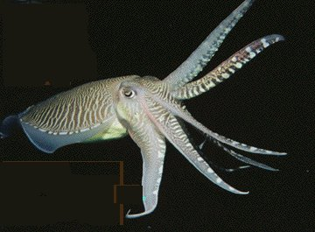
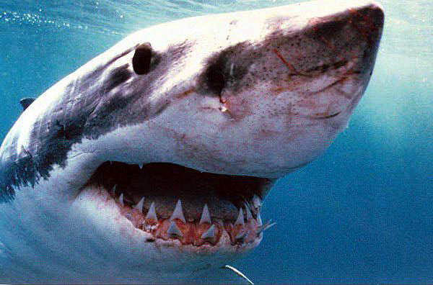
Most Consumer Species Feed on Live Organisms of Other Species
Predators may capture prey by:
Walking
Swimming
Flying
Pursuit and ambush
Camouflage
Chemical warfare

Slide 13
Most Consumer Species Feed on Live Organisms of Other Species
Prey may avoid capture by
Camouflage
Chemical warfare
Warning coloration
Mimicry
Deceptive looks
Deceptive behavior

Slide 14
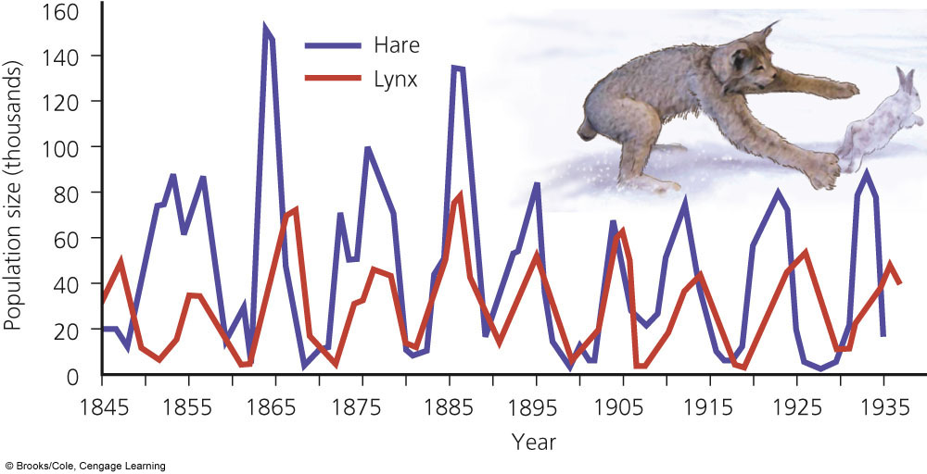
Predation: Population Control
Cyclic fluctuations, boom-and-bust cycles
Top-down population regulation
Controlled by predation
Bottom-up population regulation
Controlled by scarcity of one or more resources

