Slide 1
Geology of Minnesota
Minnesota Landforms

Slide 2
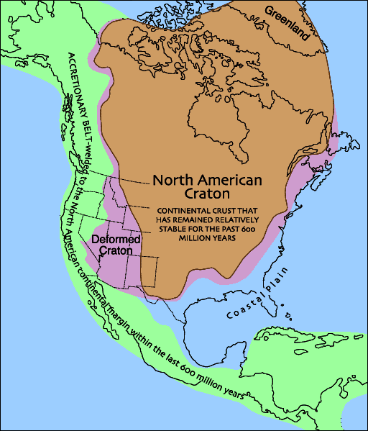
Minnesota’s Rocks are old
Minnesota lies in the middle of the North American Craton
These rocks are more than 545 million years old
They are referred to as Precambrian
Anything older than 600 million years old

Slide 3
Weathering & Erosion
Weathering is the decay and breaking of rocks into smaller pieces.
Weathering is the result of the interactions of air, water, and temperature on exposed rock surfaces and prepares the rock for erosion.
Erosion is the movement of the particles by ice, wind, or water.
The particles are then transported by that agent until they are deposited to form sedimentary deposits, which can be later eroded again or transformed into sedimentary rocks.

Slide 4
Two Types of weathering
Mechanical weathering is the physical breaking of rocks into smaller pieces (the composition of the rocks stay the same).
Example: Rocks hitting other rocks in a river (caused by the moving water) physically breaks off the sharp edges and rounds the rocks.
Chemical weathering is the breakdown or decay of rocks by chemically changing the composition of the rock.
Example: A weak acid (such as vinegar) will breakdown limestone by chemically changing some of the rock into a gas (carbon dioxide, CO₂) which bubbles off.

Slide 5
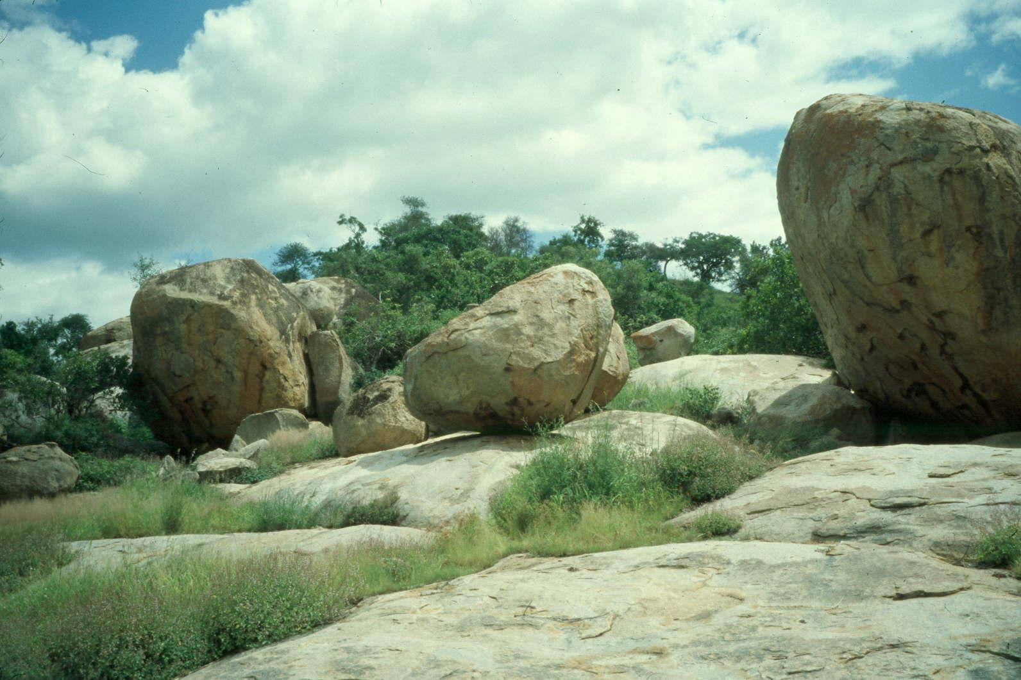
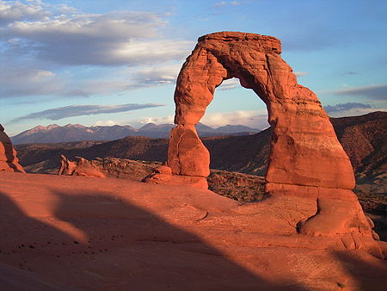
Weathering patterns
A spherically weathered boulder forms when the corners of an angular rock are broken down more quickly than the flat surfaces, forming rounded shapes.
Differential weathering results when some rocks resist weathering more than other rocks, creating uneven rates of weathering and erosion.

Slide 6
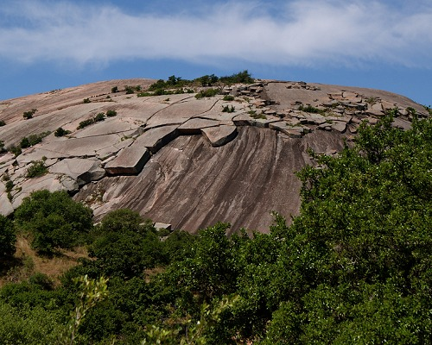
Weathering terms - mechanical
Exfoliation: the peeling away of outer layers of a rock when pressure is taken off the rock, or when the rock expands & contracts due to temperature change.

Slide 7
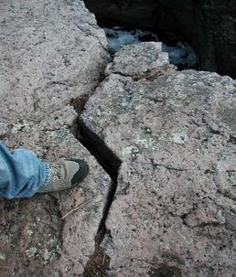
Weathering terms - mechanical
Ice Wedging: water freezing and thawing in the cracks of rock can break it apart and allow the water to seep deeper.

Slide 8
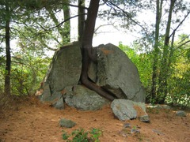
Weathering terms - mechanical
Organic Activity: as plant roots grow they can force apart rocks, and animals and insects can dig and breakdown rock.

Slide 9
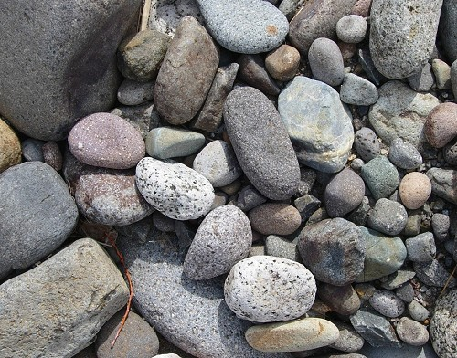
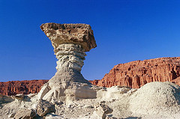
Weathering terms - mechanical
Abrasion: rocks hitting each other can breakdown the outer surface of the rocks. Abrasion can be caused by:
1. Water currents in rivers and streams forcing rocks to hit each other.
2. Water in ocean waves crashing against shorelines can pound rock into smaller pieces.
3. Wind carrying sand can breakdown and “sandblast” rock.
4. Glaciers (containing bits of sand and rock) sliding down mountains can grind against the underlying rock and break some of it off.

Slide 10
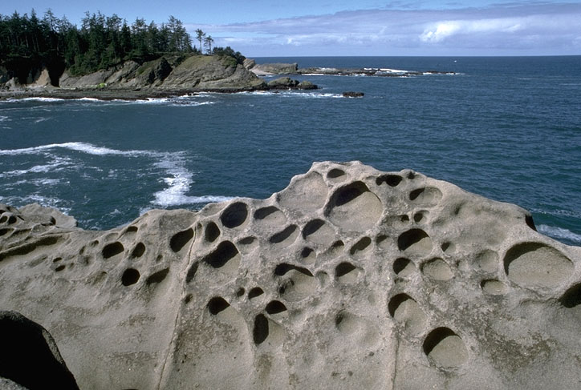
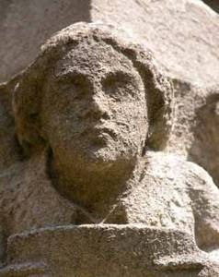
Weathering terms - chemical
Hydrolysis: when water chemically reacts with, and changes, the minerals in rock.

Slide 11
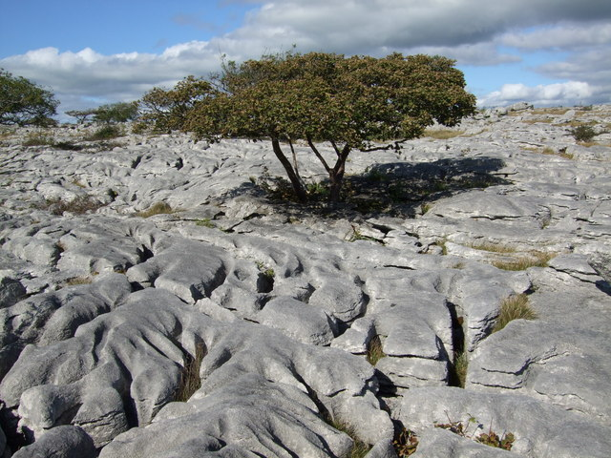
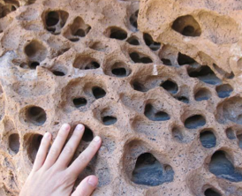
Weathering terms - chemical
Carbonation: when carbonic acid reacts with, and changes, the minerals in rock (CO₂ bubbles are released).

Slide 12
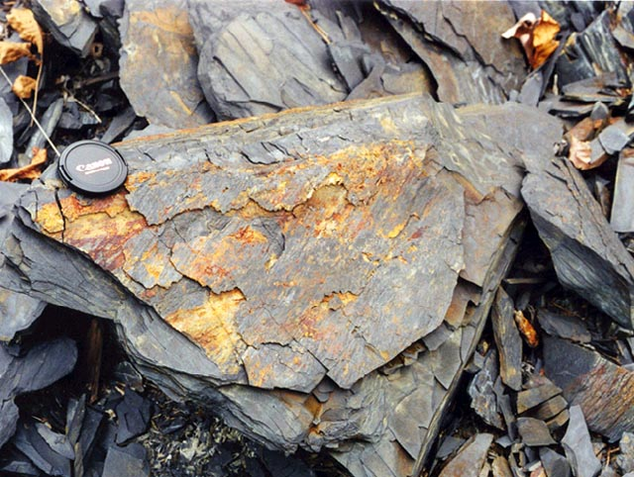
Weathering terms - chemical
Oxidation: when oxygen from water or the air reacts with and changes metallic elements in rock. Note: rust is one form of oxidation.

Slide 13
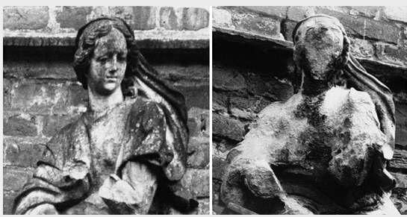
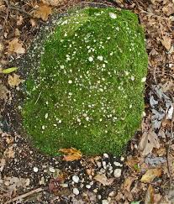
Weathering terms - chemical
Other Acid Reactions: acid can react with and change the minerals in rock. The acid can be naturally occurring (example: moss and lichens which grown on rocks) or can be manmade (example: acid rain caused by air pollution).

Slide 14
Activity: weathering stations
Move about the room to the different stations
Follow the directions at each station
Draw a picture of what happened
Describe what happened
List the type of Mechanical or Chemical erosion demonstrated on the blank provided

